Slide 1
BIE ELA Writing Webinar
February 13, 2025
1

Slide 2
Welcome & Purpose
Welcome from the Chief Academic Office and the ELA Assessment Team.
Aurelia Shorty, Dr. Carmelia Becenti, & Dr. BJ Howerton
The purpose of this training is to:
Provide information and raise awareness about the Prose Constructed Response (Writing) items on the BIE ELA Summative and ELA Interim 2 tests

Slide 3
Housekeeping
Training PowerPoint will be posted to https://bie.mypearsonsupport.com/
Training will be recorded.
Please be sure to mute your microphone, if applicable.
Questions may be posted in the Q&A.

Slide 4
Agenda
General Overview
Glossary of Terms
ELA/Literacy Task Types
Resources
ELA/Literacy Short Form Blueprints
Scoring Rubrics/Traits
Total score with weighting
Released Items/Scored Sample Responses
Writing Results on Individual Student Report (ISR)

Slide 5
General Overview
BIE writing items are “Prose Constructed Response” (PCR) item types.
One PCR item is on each ELA Interim 2 test.
Two PCR items are on the ELA Summative test: one in Unit 1 and one in Unit 2.

Slide 6
General Overview
While word count or length of the response are not criteria on the scoring rubric, a student who writes very little is likely to have a low score, as development of ideas, organization, and control of conventions cannot be assessed without a student demonstrating those skills through writing a sufficient amount. One or two sentences is not likely to be enough to receive above the lowest scale score.
If a student does not respond to the PCR item(s), the total score for the ELA test is likely to be low because the PCR is a significant part of the total score for the ELA test.

Slide 7
General Overview
Approximately 30% of ELA students did not respond at all or did not respond with an on-topic essay to the PCR items on the BIE Spring 2024 Summative test.

Slide 8
Glossary of Terms
Anchor Set | Carefully selected student responses that exemplify the rubric at each score point. Scorers compare student responses to the anchor papers throughout training and scoring Anchor sets are provided as the sample student responses for released items: https://resources.newmeridiancorp.org/released-items/
Conventions | Knowledge of Language and Conventions trait, second trait scored for PCR item types. Control of grammar, usage, and mechanics are evaluated under the Conventions trait.
​ PCR​ ​ | ​ Prose Constructed Response, this is the writing item on the interim and summative test. ​
RCWE​ or Reading Comprehension/Written Expression | Reading Comprehension and Written Expression trait. RCWE is the first trait on the scoring rubric for RST and LAT​ types. Comprehension, development, use of text-based support, organization, and use of language are evaluated under the RCWE trait.
​ RST​ ​ | ​ Research Simulation Task ​ ​
​ Rubric​ ​ | ​ Scale used to assign scores to responses​ ​
Trait​ | Specific Characteristics or qualities in each response that are evaluated separately​
​ WE ​or Written Expression ​ | ​ Written Expression trait. WE is the first trait on the rubric for NWT​. Development, organization, and use of language are evaluated under the WE trait. ​

Slide 9
ELA Task Types
On the Summative test, students will respond to a writing prompt for two of three task types. On the ELA Interim 2 test, students will respond to a writing prompt for one of the three task types:
Literary Analysis Task (LAT)​
Research Simulation Task (RST)​
Narrative Writing Task (NWT)​

Slide 10
ELA Task Types
Literary Analysis Task (LAT)​
Students are given a prompt that asks them to write an analysis of the two literary passages in the set, explaining how the pieces are connected through a discussion of the passages' themes and structures.​
The traits scored using the grade level Literary Analysis Task rubric are:​
Trait 1: Reading Comprehension and Written Expression​
Trait 2: Knowledge of Language and Conventions

Slide 11
ELA Task Types
Research Simulation Task (RST)​
Students are given a prompt that asks them to write an analysis of multiple informational passages, explaining how the passages are connected or discussing ideas presented within the passages. ​
The traits scored using the grade level Research Simulation Task rubric are:​
Trait 1: Reading Comprehension and Written Expression​
Trait 2: Knowledge of Language and Conventions

Slide 12
ELA Task Types
Narrative Writing Task (NWT)​
Students are given a prompt that they use as a springboard for writing a story of their own, one that continues the storyline of a literary passage or that narrates the events in the passage from a different character's perspective. These items allow students to use creativity through storytelling. ​
The traits scored using the grade level Narrative Writing Task rubric are:​
Trait 1: Written Expression​
Trait 2: Knowledge of Language and Conventions

Slide 13
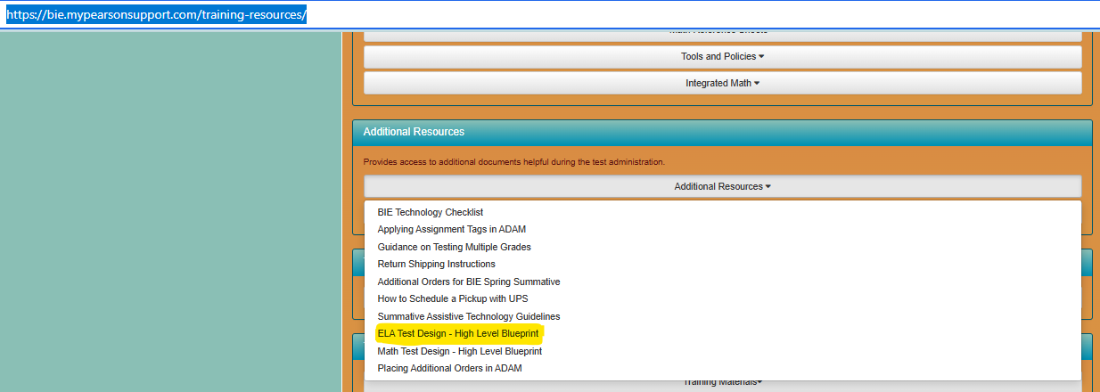
Resources: ELA/Literacy Short Form Blueprints
Go to https://bie.mypearsonsupport.com/training-resources
Additional Resources/ELA Test Design – High Level Blueprint

Slide 14
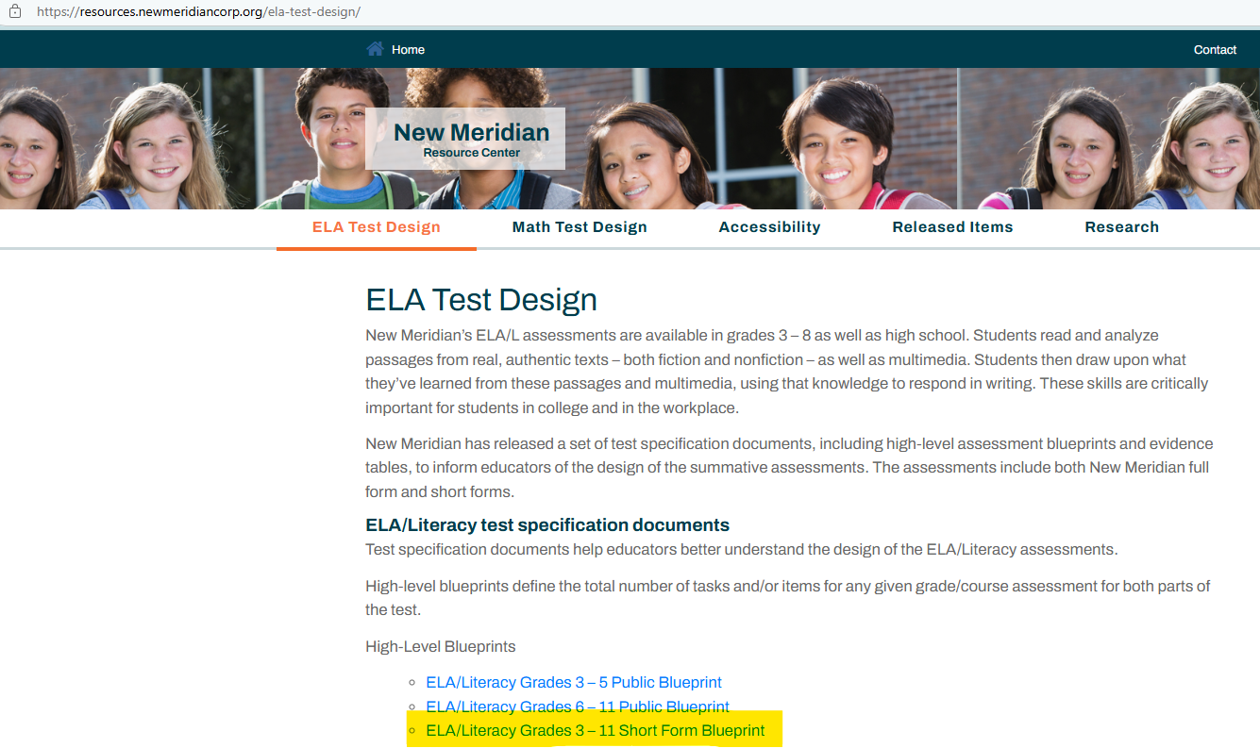
Resources: ELA/Literacy Short Form Blueprints
This will take you to the New Meridian Resource Center/ELA Test Design.
Scroll down to find the Grades 3 through 11 ELA/Literacy Short Form Blueprint link.

Slide 15
Resources: ELA/Literacy Scoring Rubrics
Go to https://bie.mypearsonsupport.com/training-resources
Additional Resources/ELA Test Design –High Level Blueprint

Slide 16
Resources: ELA/Literacy Scoring Rubrics
This will take you to the New Meridian Resource Center/ELA Test Design.
Scroll down to find the Grades 3 through 11 ELA/Literacy Scoring Rubrics link.

Slide 17
Resources: ELA/Literacy Scoring Rubrics Traits Scored
Trait scoring is used to evaluate constructed responses where scores are based on multiple aspects of student performance.​
Reading Comprehension & Written Expression (LAT and RST tasks)​
Scorers evaluate the following factors in a student response:​
The range of accuracy in expressing reading comprehension​
The quality of evidence cited from sources provided​
Development of ideas, including when drawing evidence from one or more sources​
Development of the topic that is appropriate to task, purpose, and audience​
Organization of writing

Slide 18
Resources: ELA/Literacy Scoring Rubrics Traits Scored
Trait scoring is used to evaluate constructed responses where scores are based on multiple aspects of student performance.​
Written Expression (NWT task)​
Scorers evaluate the following factors in a student response:​
Development of ideas​
Narrative elements consistent with the task​
Organization of writing ​

Slide 19
Resources: ELA/Literacy Scoring Rubrics Traits Scored
Trait scoring is used to evaluate constructed responses where scores are based on multiple aspects of student performance.​
Knowledge of Language and Conventions (all task types)​
Scorers evaluate the following factors in a student response:​
Command of grammar​
Language usage​
Mechanics
Capitalization
Punctuation
Spelling
Sentence Structure​

Slide 20
Resources: ELA/Literacy PCRs Total Scores and Weighting
The Written Expression component on a PCR item is weighted by a factor of three for the purpose of computing the student’s overall raw score for the written component of the test. ​
Written Expression is weighted to strike an appropriate balance of raw score points between the Reading and Writing claims on the ELA tests. ​
The amount of time and effort it takes the typical student to respond to a PCR item is significantly more than the time and effort it takes to answer an Evidence-Based Selected Response (EBSR) or a Technology Enhanced Constructed Response item ​(TECR)
Weighting the Written Expression component by a factor of 3 is the method our program has established to make the Reading and Writing claims worth an approximate equivalent number of raw score points, and to reflect (roughly) the equivalent amount of time and effort we expect students to deploy in the course of demonstrating their proficiency in reading and writing.​

Slide 21
Resources: ELA/Literacy PCRs Total Scores and Weighting
The Reading Comprehension and the Knowledge of Language and Conventions scores are not weighted but rather are carried directly over to the student’s overall raw score for the written component.​
The maximum Points for the writing prompt are 12, 15, or 19, depending on the task type and grade level.

Slide 22
Resources: ELA/Literacy PCRs Total Scores and Weighting
Example of trait scoring with weighting to arrive at final PCR item score:​
Grade 4 Student Score for written response on a Literary Analysis Task​
Trait 1: Reading Comprehension and Written Expression​
Score achieved is 3 out of 4 points, the 3 points are applied to the trait as follows:​
Reading Comprehension: 3​
Written Expression: 3 points x 3 = 9​
Trait 2: Knowledge of Language and Conventions​
Score achieved is 2 out of 3 points: 2​
Total Score for PCR 14 points out of 19 possible

Slide 23
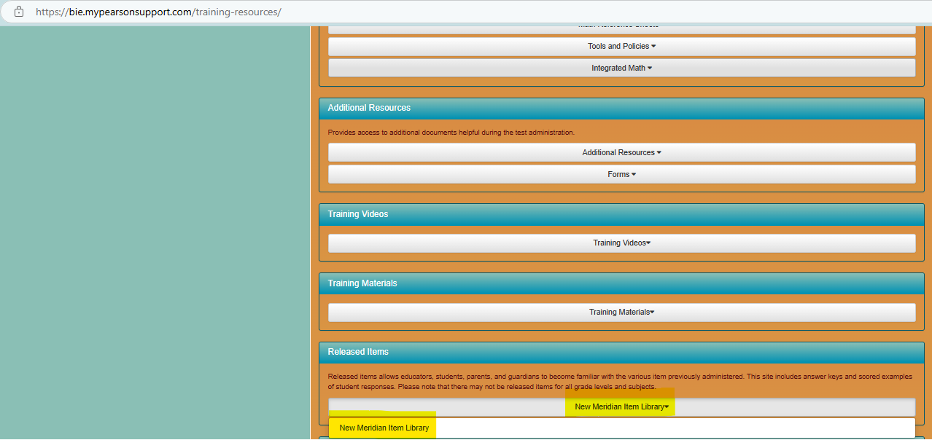
Resources: ELA/Literacy Released Items and Sample Student Responses
Go to https://bie.mypearsonsupport.com/training-resources
Resources: ELA/Literacy Released Items and Sample Student Responses

Slide 24
Resources: Released Items and Sample Student Responses
Steps to access sample responses:
Select English Language Arts.
Then, select the grade
and “Sample Student Responses.”

Slide 25
Writing Results on Summative ISR

Slide 26
End of Presentation
26
Notes:
Closing Slide

